Slide 1
Chapter 21: Parallel Databases

Slide 2
Chapter 21: Parallel Databases
Introduction
I/O Parallelism
Interquery Parallelism
Intraquery Parallelism
Intraoperation Parallelism
Interoperation Parallelism
Design of Parallel Systems

Slide 3

Introduction
Parallel machines are becoming quite common and affordable
  Prices of microprocessors, memory and disks have dropped sharply
  Recent desktop computers feature multiple processors and this trend is projected to accelerate
Databases are growing increasingly large
  large volumes of transaction data are collected and stored for later analysis.
  multimedia objects like images are increasingly stored in databases
Large-scale parallel database systems increasingly used for:
  storing large volumes of data
  processing time-consuming decision-support queries
  providing high throughput for transaction processing

Slide 4
Parallelism in Databases
Data can be partitioned across multiple disks for parallel I/O.
Individual relational operations (e.g., sort, join, aggregation) can be executed in parallel
  data can be partitioned and each processor can work independently on its own partition.
Queries are expressed in high level language (SQL, translated to relational algebra)
  makes parallelization easier.
Different queries can be run in parallel with each other. Concurrency control takes care of conflicts.
Thus, databases naturally lend themselves to parallelism.

Slide 5
I/O Parallelism
Reduce the time required to retrieve relations from disk by partitioning
the relations on multiple disks.
Horizontal partitioning – tuples of a relation are divided among many disks such that each tuple resides on one disk.
Partitioning techniques (number of disks = n):
  Round-robin:
    Send the i^{th} tuple inserted in the relation to disk i mod n.
  Hash partitioning:
  Choose one or more attributes as the partitioning attributes.
  Choose hash function h with range 0…n - 1
  Let i denote result of hash function h applied to the partitioning attribute value of a tuple. Send tuple to disk i.

Slide 6
I/O Parallelism (Cont.)
Partitioning techniques (cont.):
Range partitioning:
  Choose an attribute as the partitioning attribute.
  A partitioning vector [v_{o}, v₁, ..., v_{n-2}] is chosen.
  Let v be the partitioning attribute value of a tuple. Tuples such that v_{i} ≤ v_{i+1} go to disk I + 1. Tuples with v < v₀ go to disk 0 and tuples with v ≥ v_{n-2} go to disk n-1.
  E.g., with a partitioning vector [5,11], a tuple with partitioning attribute value of 2 will go to disk 0, a tuple with value 8 will go to disk 1, while a tuple with value 20 will go to disk2.

Slide 7
Comparison of Partitioning Techniques
Evaluate how well partitioning techniques support the following types of data access:
1.Scanning the entire relation.
2.Locating a tuple associatively – point queries.
  E.g., r.A = 25.
3.Locating all tuples such that the value of a given attribute lies within a specified range – range queries.
  E.g., 10 ≤ r.A < 25.

Slide 8
Comparison of Partitioning Techniques (Cont.)
Round robin:
Advantages
  Best suited for sequential scan of entire relation on each query.
  All disks have almost an equal number of tuples; retrieval work is thus well balanced between disks.
Range queries are difficult to process
  No clustering -- tuples are scattered across all disks

Slide 9
Comparison of Partitioning Techniques(Cont.)
Hash partitioning:
Good for sequential access
  Assuming hash function is good, and partitioning attributes form a key, tuples will be equally distributed between disks
  Retrieval work is then well balanced between disks.
Good for point queries on partitioning attribute
  Can lookup single disk, leaving others available for answering other queries.
  Index on partitioning attribute can be local to disk, making lookup and update more efficient
No clustering, so difficult to answer range queries

Slide 10
Comparison of Partitioning Techniques (Cont.)
Range partitioning:
Provides data clustering by partitioning attribute value.
Good for sequential access
Good for point queries on partitioning attribute: only one disk needs to be accessed.
For range queries on partitioning attribute, one to a few disks may need to be accessed
  Remaining disks are available for other queries.
  Good if result tuples are from one to a few blocks.
  If many blocks are to be fetched, they are still fetched from one to a few disks, and potential parallelism in disk access is wasted
    Example of execution skew.

Slide 11
Partitioning a Relation across Disks
If a relation contains only a few tuples which will fit into a single disk block, then assign the relation to a single disk.
Large relations are preferably partitioned across all the available disks.
If a relation consists of m disk blocks and there are n disks available in the system, then the relation should be allocated min(m,n) disks.

Slide 12
Handling of Skew
The distribution of tuples to disks may be skewed — that is, some disks have many tuples, while others may have fewer tuples.
Types of skew:
  Attribute-value skew.
    Some values appear in the partitioning attributes of many tuples; all the tuples with the same value for the partitioning attribute end up in the same partition.
    Can occur with range-partitioning and hash-partitioning.
  Partition skew.
    With range-partitioning, badly chosen partition vector may assign too many tuples to some partitions and too few to others.
    Less likely with hash-partitioning if a good hash-function is chosen.

Slide 13
Handling Skew in Range-Partitioning
To create a balanced partitioning vector (assuming partitioning attribute forms a key of the relation):
  Sort the relation on the partitioning attribute.
  Construct the partition vector by scanning the relation in sorted order as follows.
    After every 1/n^{th} of the relation has been read, the value of the partitioning attribute of the next tuple is added to the partition vector.
  n denotes the number of partitions to be constructed.
  Duplicate entries or imbalances can result if duplicates are present in partitioning attributes.
Alternative technique based on histograms used in practice

Slide 14
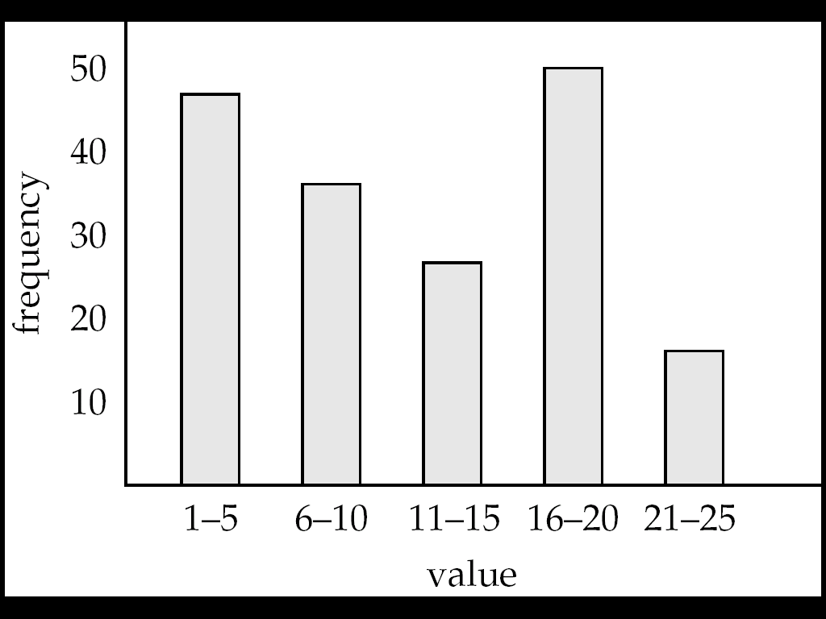
Handling Skew using Histograms
Balanced partitioning vector can be constructed from histogram in a relatively straightforward fashion
  Assume uniform distribution within each range of the histogram
Histogram can be constructed by scanning relation, or sampling (blocks containing) tuples of the relation

Slide 15
Interquery Parallelism
Queries/transactions execute in parallel with one another.
Increases transaction throughput; used primarily to scale up a transaction processing system to support a larger number of transactions per second.
Easiest form of parallelism to support, particularly in a shared-memory parallel database, because even sequential database systems support concurrent processing.
More complicated to implement on shared-disk or shared-nothing architectures
  Locking and logging must be coordinated by passing messages between processors.
  Data in a local buffer may have been updated at another processor.
  Cache-coherency has to be maintained — reads and writes of data in buffer must find latest version of data.

Slide 16
Intraquery Parallelism
Execution of a single query in parallel on multiple processors/disks; important for speeding up long-running queries.
Two complementary forms of intraquery parallelism :
  Intraoperation Parallelism – parallelize the execution of each individual operation in the query.
  Interoperation Parallelism – execute the different operations in a query expression in parallel.
the first form scales better with increasing parallelism because
the number of tuples processed by each operation is typically more than the number of operations in a query

Slide 17
Parallel Processing of Relational Operations
Our discussion of parallel algorithms assumes:
  read-only queries
  shared-nothing architecture
  n processors, P₀, ..., P_{n-1}, and n disks D₀, ..., D_{n-1}, where disk D_{i} is associated with processor P_{i}.
If a processor has multiple disks they can simply simulate a single disk D_{i}.
Shared-nothing architectures can be efficiently simulated on shared-memory and shared-disk systems.
  Algorithms for shared-nothing systems can thus be run on shared-memory and shared-disk systems.
  However, some optimizations may be possible.

Slide 18
Parallel Sort
Range-Partitioning Sort
Choose processors P₀, ..., P_{m}, where m ≤ n -1 to do sorting.
Create range-partition vector with m entries, on the sorting attributes
Redistribute the relation using range partitioning
  all tuples that lie in the i^{th} range are sent to processor P_{i}
  P_{i} stores the tuples it received temporarily on disk D_{i}.
  This step requires I/O and communication overhead.
Each processor P_{i} sorts its partition of the relation locally.
Each processors executes same operation (sort) in parallel with other processors, without any interaction with the others (data parallelism).
Final merge operation is trivial: range-partitioning ensures that, for 1 j m, the key values in processor P^{i} are all less than the key values in P_{j}.

Slide 19
Parallel Join
The join operation requires pairs of tuples to be tested to see if they satisfy the join condition, and if they do, the pair is added to the join output.
Parallel join algorithms attempt to split the pairs to be tested over several processors. Each processor then computes part of the join locally.
In a final step, the results from each processor can be collected together to produce the final result.

Slide 20
Partitioned Join
For equi-joins and natural joins, it is possible to partition the two input relations across the processors, and compute the join locally at each processor.
Let r and s be the input relations, and we want to compute r _{r.A=s.B} s.
r and s each are partitioned into n partitions, denoted r₀, r₁, ..., r_{n-1} and s₀, s₁, ..., s_{n-1}.
Can use either range partitioning or hash partitioning.
r and s must be partitioned on their join attributes r.A and s.B), using the same range-partitioning vector or hash function.
Partitions r_{i} and s_{i} are sent to processor P_{i},
Each processor P_{i} locally computes r_{i} _{ri.A=si.B} s_{i}. Any of the standard join methods can be used.

Slide 21
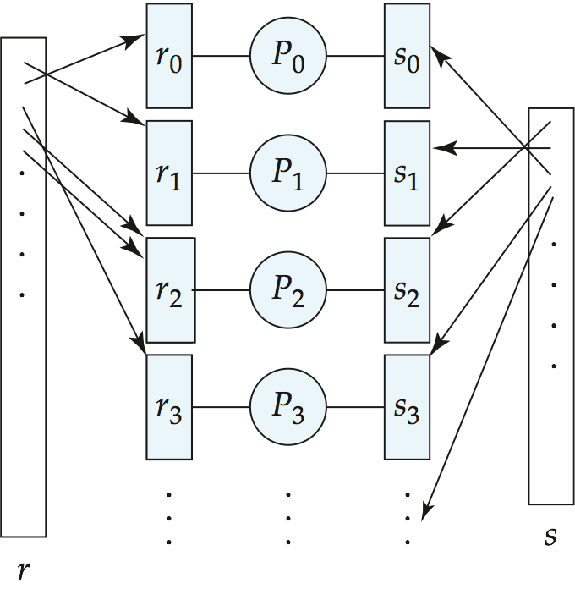
Partitioned Join (Cont.)

Slide 22
Fragment-and-Replicate Join
Partitioning not possible for some join conditions
  E.g., non-equijoin conditions, such as r.A > s.B.
For joins were partitioning is not applicable, parallelization can be accomplished by fragment and replicate technique
  Depicted on next slide
Special case – asymmetric fragment-and-replicate:
  One of the relations, say r, is partitioned; any partitioning technique can be used.
  The other relation, s, is replicated across all the processors.
  Processor P_{i} then locally computes the join of r_{i} with all of s using any join technique.

Slide 23
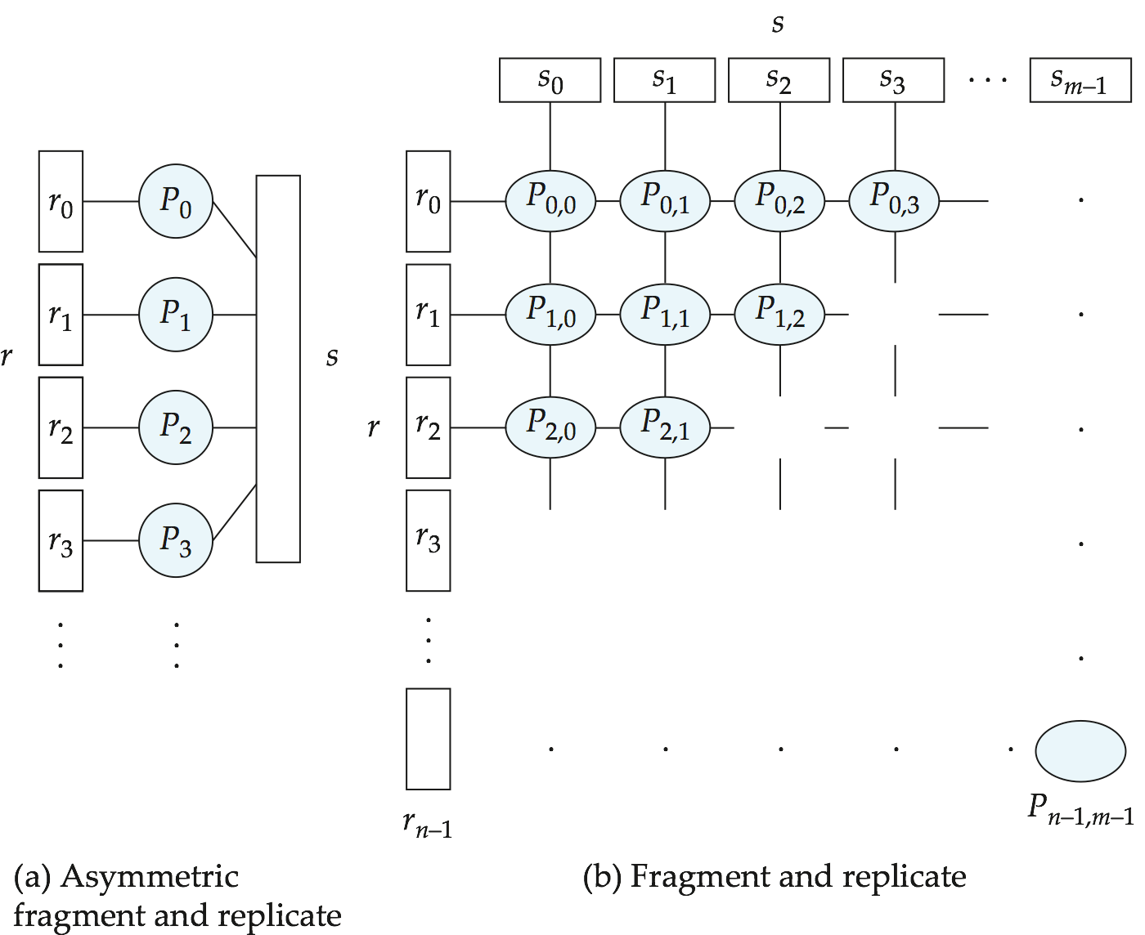
Depiction of Fragment-and-Replicate Joins

Slide 24
Design of Parallel Systems
Some issues in the design of parallel systems:
Parallel loading of data from external sources is needed in order to handle large volumes of incoming data.
Resilience to failure of some processors or disks.
  Probability of some disk or processor failing is higher in a parallel system.
  Operation (perhaps with degraded performance) should be possible in spite of failure.
  Redundancy achieved by storing extra copy of every data item at another processor.

